Slide 1



Noida Institute of Engineering and Technology, Greater Noida
INTRODUCTION OF ARTIFICIAL INTELLIGENCE
Unit: 01
ARTIFICIAL INTELLIGENCE
Alka Singh
AIML
B Tech 3rd Sem

Slide 2
Well –Posed or Well-Defined Learning Problems:
Tom Mitchell’s definition of Machine Learning
A Computer program is said to learn from experience E for some class of tasks T and performance measure P if its performance on tasks T as measured by P improves with experience E.
A well – posed learning problem must have following three features:
The class of Tasks
Measure of performance
Source of Experience

Slide 3
Certain examples that efficiently defines the well-posed learning problem are –
To better filter emails as spam or not
Task T – Classifying emails as spam or not
Performance Measure P – The fraction of emails accurately classified as spam or not spam
Experience E– Observing you label emails as spam or not spam

Slide 4
Certain examples that efficiently defines the well-posed learning problem are –
2. A checkers learning problem
Task T – Playing checkers game
Performance Measure P – percent of games won against opponent
Experience E – playing implementation games against itself

Slide 5
Certain examples that efficiently defines the well-posed learning problem are –
3. Handwriting Recognition Problem
Task T – recognizing and classifying handwritten words within images
Performance Measure P – percent of words accurately classified
Experience E – a database of handwritten words with given classifications

Slide 6
Certain examples that efficiently defines the well-posed learning problem are –
4. A Robot Driving Problem
Task T – driving on public four-lane highways using vision sensors
Performance Measure P – average distance travelled before an error (as judged by human overseer)
Experience E– a sequence of images and steering commands recorded while observing a human driver

Slide 7
Certain examples that efficiently defines the well-posed learning problem are –
5. Face Recognition Problem
Task T – predicting different types of faces
Performance Measure P – able to predict maximum types of faces
Experience E – training machine with maximum amount of datasets of different face images

Slide 8
Certain examples that efficiently defines the well-posed learning problem are –
6. Automatic Translation of documents
Task T – translating one type of language used in a document to other language
Performance Measure P – able to convert one language to other efficiently
Experience E – training machine with a large dataset of different types of languages

Slide 9
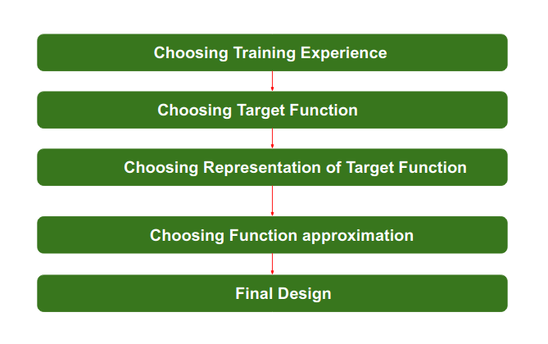
Steps for Designing Learning System are:

Slide 10
Step 1 : Choosing the Training Experience:
The very important and first task is to choose the training data or training experience which will be fed to the Machine Learning Algorithm.
It is important to note that the data or experience that we fed to the algorithm must have a significant impact on the Success or Failure of the Model.
So Training data or experience should be chosen wisely.

Slide 11
Step 1 : Choosing the Training Experience:
Below are the attributes which will impact on Success and Failure of Data:
The training experience will be able to provide direct or indirect feedback regarding choices. For example: While Playing chess the training data will provide feedback to itself like instead of this move if this is chosen the chances of success increases.

Slide 12
Step 1 : Choosing the Training Experience:
Second important attribute is the degree to which the learner will control the sequences of training examples.
For example: when training data is fed to the machine then at that time accuracy is very less but when it gains experience while playing again and again with itself or opponent the machine algorithm will get feedback and control the chess game accordingly.

Slide 13
Step 1 : Choosing the Training Experience:
Third important attribute is how it will represent the distribution of examples over which performance will be measured.
For example, a Machine learning algorithm will get experience while going through a number of different cases and different examples. Thus, Machine Learning Algorithm will get more and more experience by passing through more and more examples and hence its performance will increase.

Slide 14
Step 2- Choosing target function:
The next important step is choosing the target function. It means according to the knowledge fed to the algorithm the machine learning will choose NextMove function which will describe what type of legal moves should be taken.
For example : While playing chess with the opponent, when opponent will play then the machine learning algorithm will decide what be the number of possible legal moves taken in order to get success.

Slide 15
Step 3- Choosing Representation for Target function:
When the machine algorithm will know all the possible legal moves the next step is to choose the optimized move using any representation i.e. using linear Equations, Hierarchical Graph Representation, Tabular form etc.
The NextMove function will move the Target move like out of these move which will provide more success rate.
For Example : while playing chess machine have 4 possible moves, so the machine will choose that optimized move which will provide success to it.

Slide 16
Step 4- Choosing Function Approximation Algorithm:
An optimized move cannot be chosen just with the training data. The training data had to go through with set of example and through these examples the training data will approximates which steps are chosen and after that machine will provide feedback on it.
For Example : When a training data of Playing chess is fed to algorithm so at that time it is not machine algorithm will fail or get success and again from that failure or success it will measure while next move what step should be chosen and what is its success rate.

Slide 17
Step 5- Final Design:
The final design is created at last when system goes from number of examples , failures and success , correct and incorrect decision and what will be the next step etc.
Example: DeepBlue is an intelligent computer which is ML-based won chess game against the chess expert Garry Kasparov, and it became the first computer which had beaten a human chess expert.

Slide 18
Problem Solving Techniques in Artificial Intelligence (AI)
Problem-solving is commonly known as the method to reach the desired goal or finding a solution to a given situation.
In Artificial Intelligence, the users can solve the problem by performing logical algorithms, utilizing polynomial and differential equations, and executing them using modeling paradigms.
There can be various solutions to a single problem, which are achieved by different heuristics. Also, some problems have unique solutions. It all rests on the nature of the given problem.

Slide 19
Examples of Problems in Artificial Intelligence
Developers worldwide are using artificial intelligence to automate systems for efficient utilization of time and resources.
Some of the most common problems encountered in day-to-day life are games and puzzles. These can be solved efficiently by using artificial intelligence algorithms.
Some of the most prevalent problems that artificial intelligence has resolved are the following:

Slide 20
Examples of Problems in Artificial Intelligence
Chess
N-Queen problem
Tower of Hanoi Problem
Travelling Salesman Problem
Water-Jug Problem

Slide 21
Problem-Solving Agent
The problem-solving agent performs precisely by defining problems and its several solutions.
According to computer science, a problem-solving is a part of artificial intelligence which encompasses a number of techniques such as algorithms, heuristics to solve a problem.
Therefore, a problem-solving agent is a goal-driven agent and focuses on satisfying the goal.

Slide 22
Steps performed by Problem-solving agent
Goal Formulation: It is the first and simplest step in problem-solving. It organizes the steps/sequence required to formulate one goal out of multiple goals as well as actions to achieve that goal. Goal formulation is based on the current situation and the agent’s performance measure
Problem Formulation: It is the most important step of problem-solving which decides what actions should be taken to achieve the formulated goal. There are following five components involved in problem formulation:

Slide 23
Steps performed by Problem-solving agent
Initial State: It is the starting state or initial step of the agent towards its goal.
Actions: It is the description of the possible actions available to the agent.
Transition Model: It describes what each action does.
Goal Test: It determines if the given state is a goal state.

Slide 24
Steps performed by Problem-solving agent
Path cost: It assigns a numeric cost to each path that follows the goal. The problem-solving agent selects a cost function, which reflects its performance measure. Remember, an optimal solution has the lowest path cost among all the solutions.

Slide 25
Steps performed by Problem-solving agent
Search: It identifies all the best possible sequence of actions to reach the goal state from the current state. It takes a problem as an input and returns solution as its output.
Solution: It finds the best algorithm out of various algorithms, which may be proven as the best optimal solution.
Execution: It executes the best optimal solution from the searching algorithms to reach the goal state from the current state.

Slide 26
State-Space
Initial state, actions, and transition model together define the state-space of the problem implicitly.
State-space of a problem is a set of all states which can be reached from the initial state followed by any sequence of actions.
The state-space forms a directed map or graph where nodes are the states, links between the nodes are actions, and the path is a sequence of states connected by the sequence of actions.

Slide 27
Example Problems
Basically, there are two types of problem approaches:
Toy Problem: It is a concise and exact description of the problem which is used by the researchers to compare the performance of algorithms.
Real-world Problem: It is real-world based problems which require solutions. Unlike a toy problem, it does not depend on descriptions, but we can have a general formulation of the problem.

Slide 28
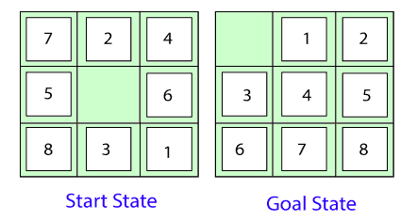
Some Toy Problems : 8 Puzzle Problem
Here, we have a 3×3 matrix with movable tiles numbered from 1 to 8 with a blank space. The tile adjacent to the blank space can slide into that space. The objective is to reach a specified goal state similar to the goal state, as shown in the below figure.

Slide 29
8 Puzzle Problem
In the above figure, our task is to convert the current(Start) state into goal state by sliding digits into the blank space.
The problem formulation is as follows:
States: It describes the location of each numbered tiles and the blank tile.
Initial State: We can start from any state as the initial state.
Actions: Here, actions of the blank space is defined, i.e., either left, right, up or down

Slide 30
8 Puzzle Problem
Transition Model: It returns the resulting state as per the given state and actions.
Goal test: It identifies whether we have reached the correct goal-state.
Path cost: The path cost is the number of steps in the path where the cost of each step is 1.

Slide 31
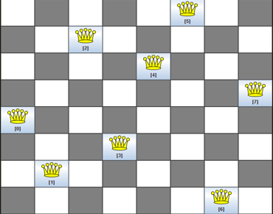
8-queens problem
The aim of this problem is to place eight queens on a chessboard in an order where no queen may attack another. A queen can attack other queens either diagonally or in same row and column.

Slide 32
8-queens problem
For this problem, there are two main kinds of formulation:
Incremental formulation: It starts from an empty state where the operator augments a queen at each step.
Following steps are involved in this formulation:
States: Arrangement of any 0 to 8 queens on the chessboard.
Initial State: An empty chessboard
Actions: Add a queen to any empty box.

Slide 33
8-queens problem
Transition model: Returns the chessboard with the queen added in a box.
Goal test: Checks whether 8-queens are placed on the chessboard without any attack.
Path cost: There is no need for path cost because only final states are counted.
In this formulation, there is approximately 1.8 x 10¹⁴ possible sequence to investigate.

Slide 34
8-queens problem
2. Complete-state formulation: It starts with all the 8-queens on the chessboard and moves them around, saving from the attacks.
Following steps are involved in this formulation
States: Arrangement of all the 8 queens one per column with no queen attacking the other queen.
Actions: Move the queen at the location where it is safe from the attacks.

Slide 35
8-queens problem
This formulation is better than the incremental formulation as it reduces the state space from 1.8 x 10¹⁴ to 2057, and it is easy to find the solutions.

Slide 36
Some Real-world problems
Traveling salesperson problem(TSP): It is a touring problem where the salesman can visit each city only once. The objective is to find the shortest tour and sell-out the stuff in each city.
VLSI Layout problem: In this problem, millions of components and connections are positioned on a chip in order to minimize the area, circuit-delays, stray-capacitances, and maximizing the manufacturing yield.

Slide 37
Problem Solving Techniques
Following are some of the standard problem-solving techniques used in AI:
Heuristics
Searching Algorithms
Evolutionary Computation
Genetic Algorithms

Slide 38
Heuristics
The heuristic method helps comprehend a problem and devises a solution based purely on experiments and trial and error methods.
However, these heuristics do not often provide the best optimal solution to a specific problem.
Instead, these undoubtedly offer efficient solutions to attain immediate goals.
Therefore, the developers utilize these when classic methods do not provide an efficient solution for the problem. Since heuristics only provide time-efficient solutions and compromise accuracy

Slide 39
Searching Algorithms
Searching is one of the primary methods of solving any problem in AI.
Rational agents or problem-solving agents use these searching algorithms to find optimal solutions.
These problem-solving agents are often goal-based and utilize atomic representation.

Slide 40
Searching Algorithms
There are following main two types of informed search algorithms:
Greedy Search
A * Search
There are the following main five types of uninformed search algorithms:
Breadth-First Search
Depth First Search

Slide 41
Searching Algorithms
Uniform Cost Search
Iterative Deepening Depth First Search
Bidirectional Search

Slide 42
Measuring problem-solving performance
There are four ways to measure the performance of an algorithm:
Completeness: It measures if the algorithm guarantees to find a solution (if any solution exist).
Optimality: It measures if the strategy searches for an optimal solution.
Time Complexity: The time taken by the algorithm to find a solution.
Space Complexity: Amount of memory required to perform a search.

